Slide 1
Chapter 1
Database Systems

Slide 2
Learning Objectives
In this chapter, you will learn:
  The difference between data and information
  What a database is, the various types of databases, and why they are valuable assets for decision making
  The importance of database design
  How modern databases evolved from file systems

Slide 3
Learning Objectives
In this chapter, you will learn:
  About flaws in file system data management
  The main components of the database system
  The main functions of a database management system (DBMS)

Slide 4
Data vs. Information
Data
Information
Raw facts
  Raw data - Not yet been processed to reveal the meaning
Building blocks of information
Data management
  Generation, storage, and retrieval of data
Produced by processing data
Reveals the meaning of data
Enables knowledge creation
Should be accurate, relevant, and timely to enable good decision making

Slide 5
Database
Shared, integrated computer structure that stores a collection of:
  End-user data - Raw facts of interest to end user
  Metadata: Data about data, which the end-user data are integrated and managed
    Describe data characteristics and relationships
Database management system (DBMS)
  Collection of programs
  Manages the database structure
  Controls access to data stored in the database

Slide 6
Role of the DBMS
Intermediary between the user and the database
Enables data to be shared
Presents the end user with an integrated view of the data
Receives and translates application requests into operations required to fulfill the requests
Hides database’s internal complexity from the application programs and users

Slide 7
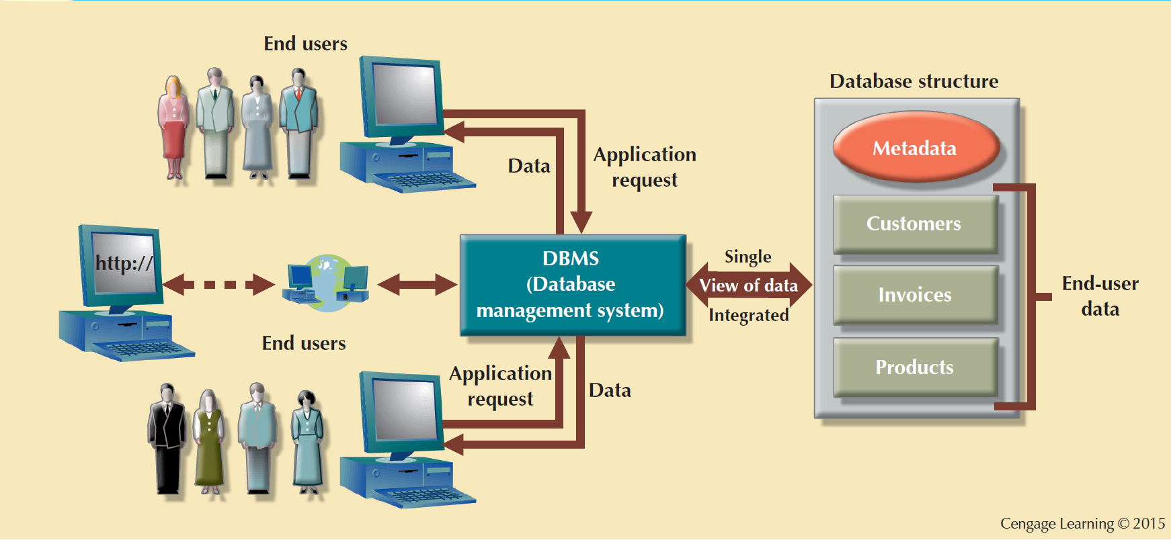
Figure 1.2 - The DBMS Manages the Interaction between the End User and the Database

Slide 8
Advantages of the DBMS
  Better data integration and less data inconsistency
    Data inconsistency: Different versions of the same data appear in different places
  Increased end-user productivity
  Improved:
  Data sharing
  Data security
  Data access
  Decision making
    Data quality: Promoting accuracy, validity, and timeliness of data

Slide 9
Types of Databases
Single-user database: Supports one user at a time
  Desktop database: Runs on PC
Multiuser database: Supports multiple users at the same time
  Workgroup databases: Supports a small number of users or a specific department
  Enterprise database: Supports many users across many departments

Slide 10
Types of Databases
Centralized database: Data is located at a single site
Distributed database: Data is distributed across different sites
Cloud database: Created and maintained using cloud data services that provide defined performance measures for the database

Slide 11
Types of Databases
General-purpose databases: Contains a wide variety of data used in multiple disciplines
Discipline-specific databases: Contains data focused on specific subject areas

Slide 12
Types of Databases
Operational database: Designed to support a company’s day-to-day operations
Analytical database: Stores historical data and business metrics used exclusively for tactical or strategic decision making
  Data warehouse: Stores data in a format optimized for decision support

Slide 13
Types of Databases
  Online analytical processing (OLAP)
    Enable retrieving, processing, and modeling data from the data warehouse
  Business intelligence: Captures and processes business data to generate information that support decision making

Slide 14
Types of Databases
Unstructured data: It exists in their original state
Structured data: It results from formatting
  Structure is applied based on type of processing to be performed
Semistructured data: Processed to some extent
Extensible Markup Language (XML)
  Represents data elements in textual format

Slide 15
Database Design
Focuses on the design of the database structure that will be used to store and manage end-user data
Well-designed database
  Facilitates data management
  Generates accurate and valuable information
Poorly designed database causes difficult-to-trace errors

Slide 16
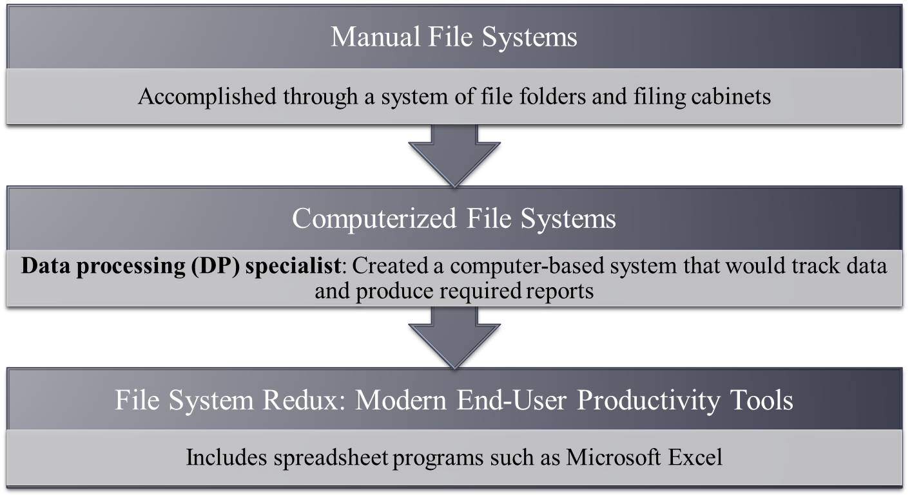
Evolution of File System Data Processing

Slide 17
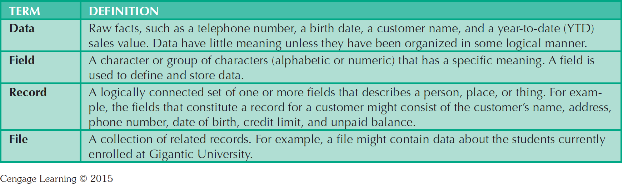
Table 1.2 - Basic File Terminology

Slide 18
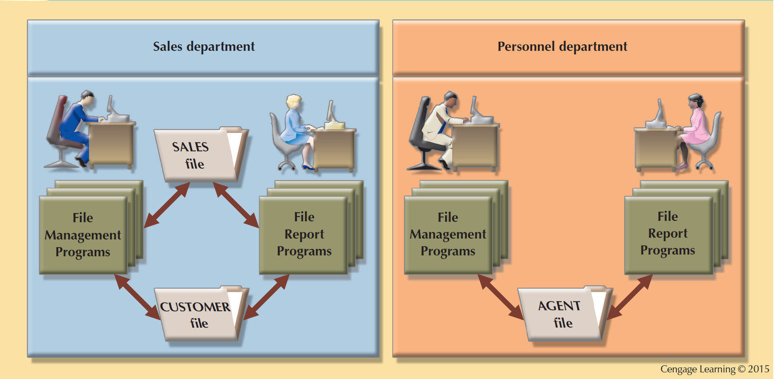
Figure1.6 - A Simple File System

Slide 19
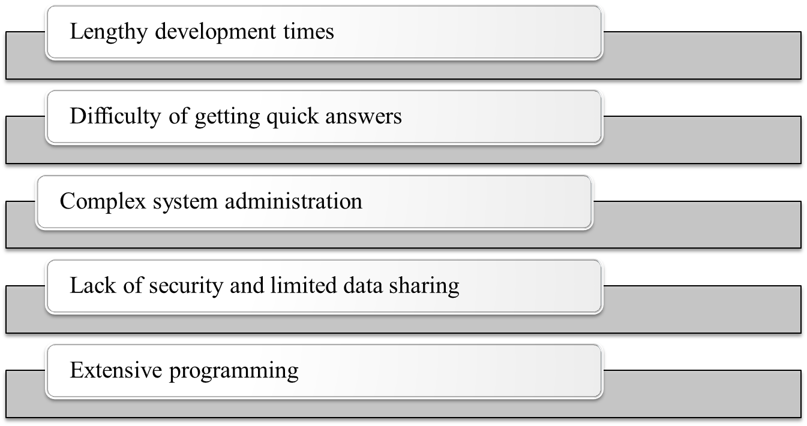
Problems with File System Data Processing

Slide 20
Structural and Data Dependence
Structural dependence: Access to a file is dependent on its own structure
  All file system programs are modified to conform to a new file structure
Structural independence: File structure is changed without affecting the application’s ability to access the data

Slide 21
Structural and Data Dependence
Data dependence
  Data access changes when data storage characteristics change
Data independence
  Data storage characteristics is changed without affecting the program’s ability to access the data
Practical significance of data dependence is difference between logical and physical format

Slide 22
Data Redundancy
Unnecessarily storing same data at different places
Islands of information: Scattered data locations
  Increases the probability of having different versions of the same data

Slide 23
Data Redundancy Implications
Poor data security
Data inconsistency
Increased likelihood of data-entry errors when complex entries are made in different files
Data anomaly: Develops when not all of the required changes in the redundant data are made successfully

Slide 24
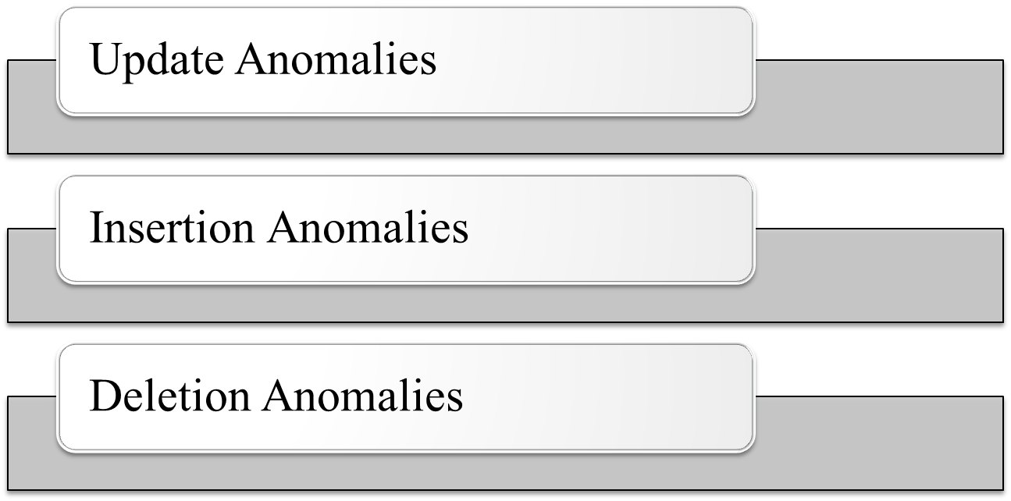
Types of Data Anomaly

Slide 25
Lack of Design and Data-Modeling Skills
Evident despite the availability of multiple personal productivity tools being available
Data-modeling skills is vital in the data design process
Good data modeling facilitates communication between the designer, user, and the developer

Slide 26
Database Systems
Logically related data stored in a single logical data repository
  Physically distributed among multiple storage facilities
  DBMS eliminates most of file system’s problems
Current generation DBMS software:
    Stores data structures, relationships between structures, and access paths
    Defines, stores, and manages all access paths and components

Slide 27
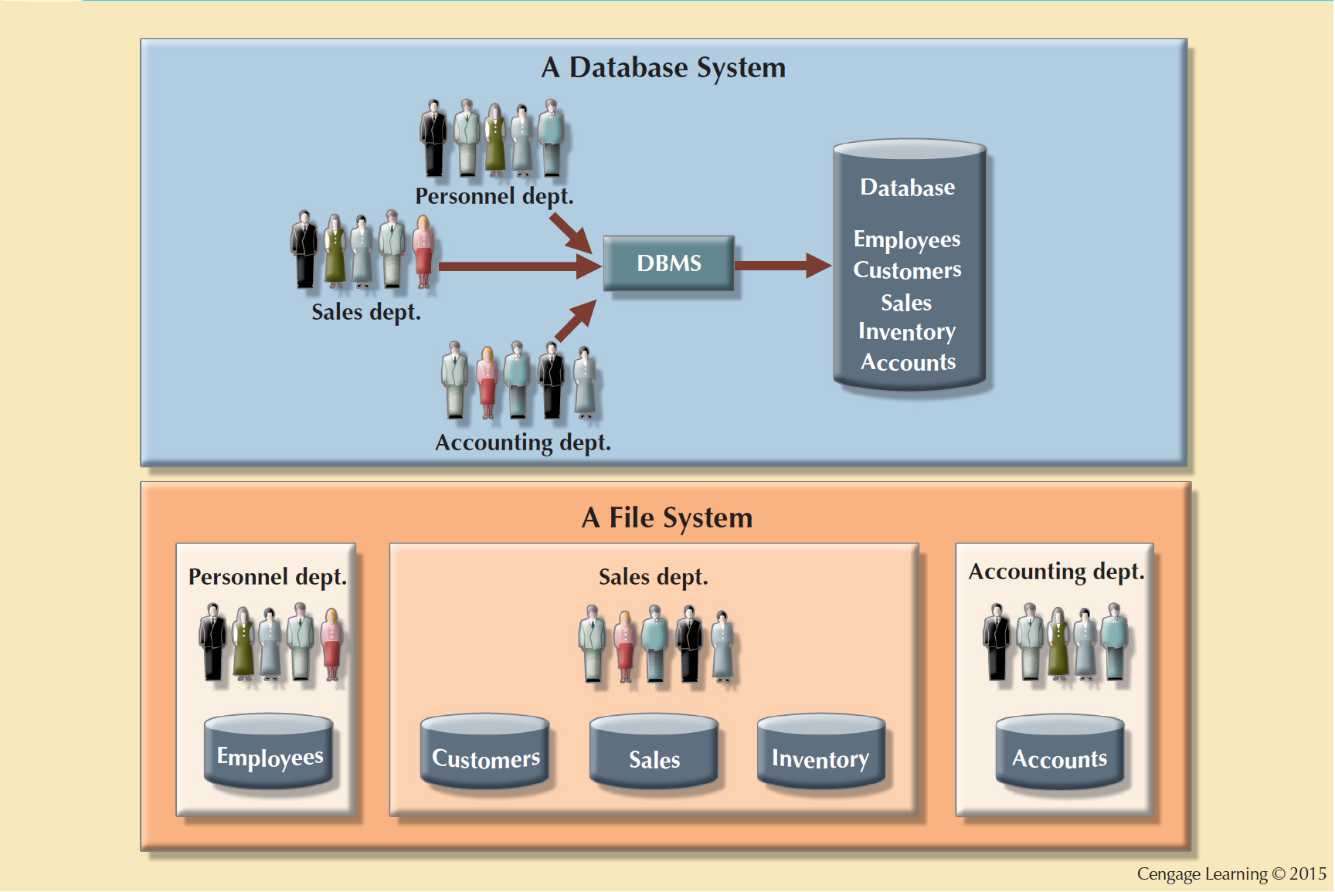
Figure 1.8 - Contrasting Database and _x001f_File Systems

Slide 28
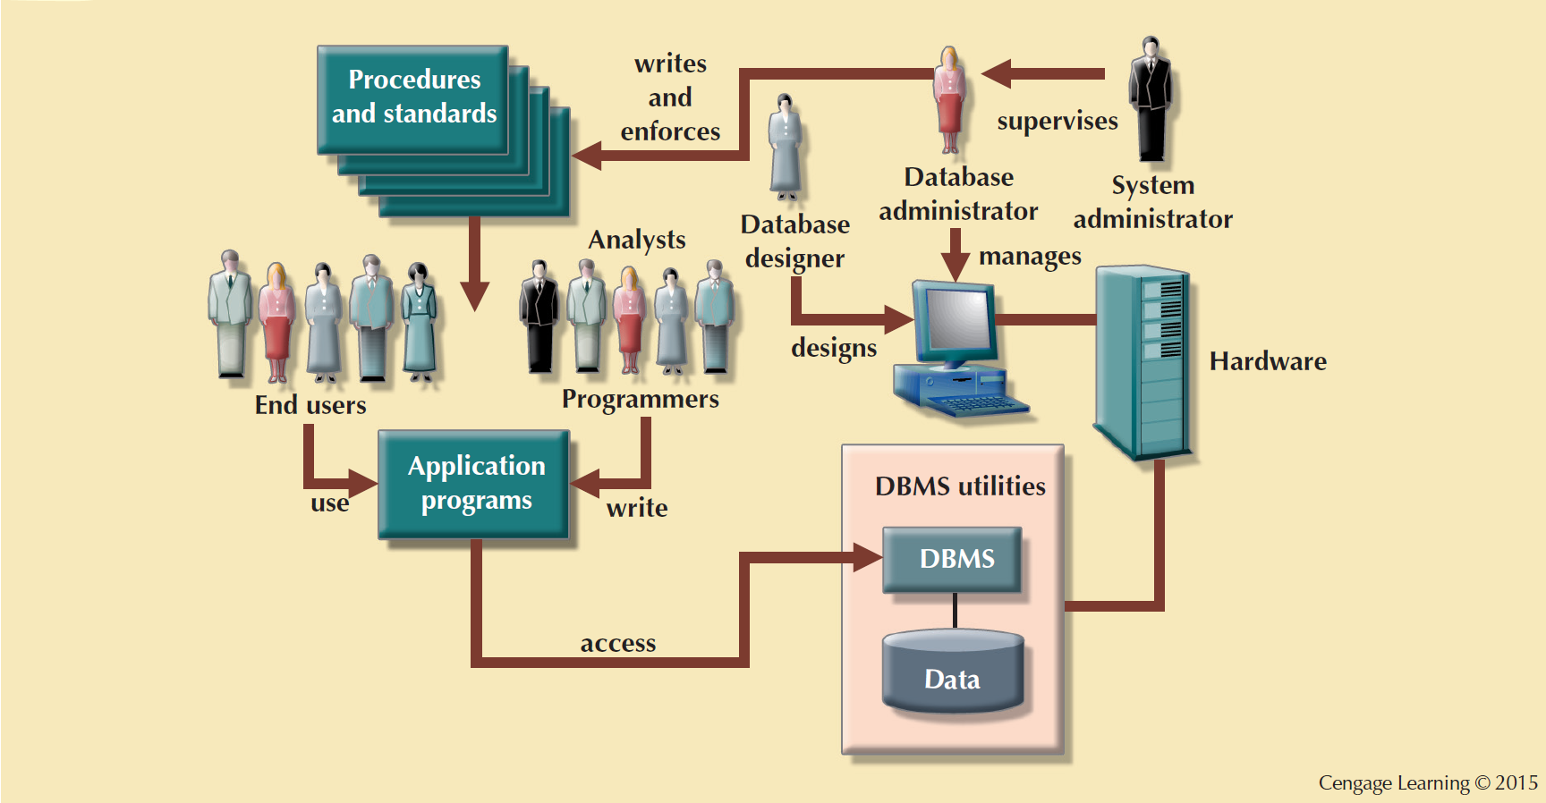
Figure 1.9 - The Database System Environment

Slide 29
DBMS Functions
Data dictionary management
  Data dictionary: Stores definitions of the data elements and their relationships
Data storage management
  Performance tuning: Ensures efficient performance of the database in terms of storage and access speed
Data transformation and presentation
  Transforms entered data to conform to required data structures
Security management
  Enforces user security and data privacy

Slide 30

DBMS Functions
Multiuser access control
  Sophisticated algorithms ensure that multiple users can access the database concurrently without compromising its integrity
Backup and recovery management
  Enables recovery of the database after a failure
Data integrity management
  Minimizes redundancy and maximizes consistency

Slide 31


DBMS Functions
Database access languages and application programming interfaces
  Query language: Lets the user specify what must be done without having to specify how
  Structured Query Language (SQL): De facto query language and data access standard supported by the majority of DBMS vendors
Database communication interfaces
  Accept end-user requests via multiple, different network environments

Slide 32
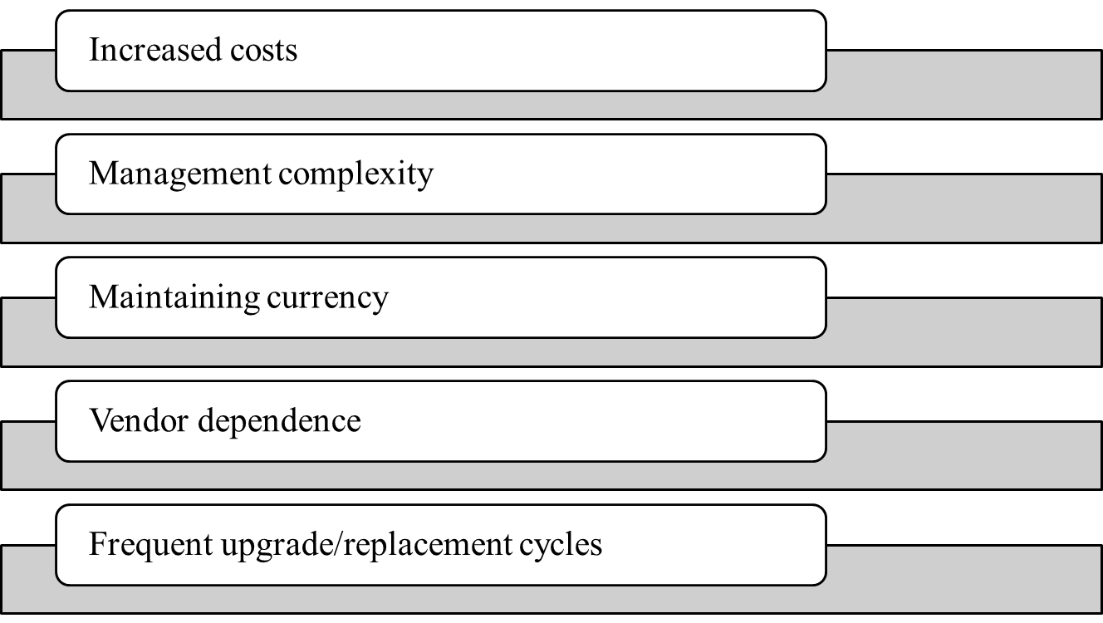
Disadvantages of Database Systems

Slide 33
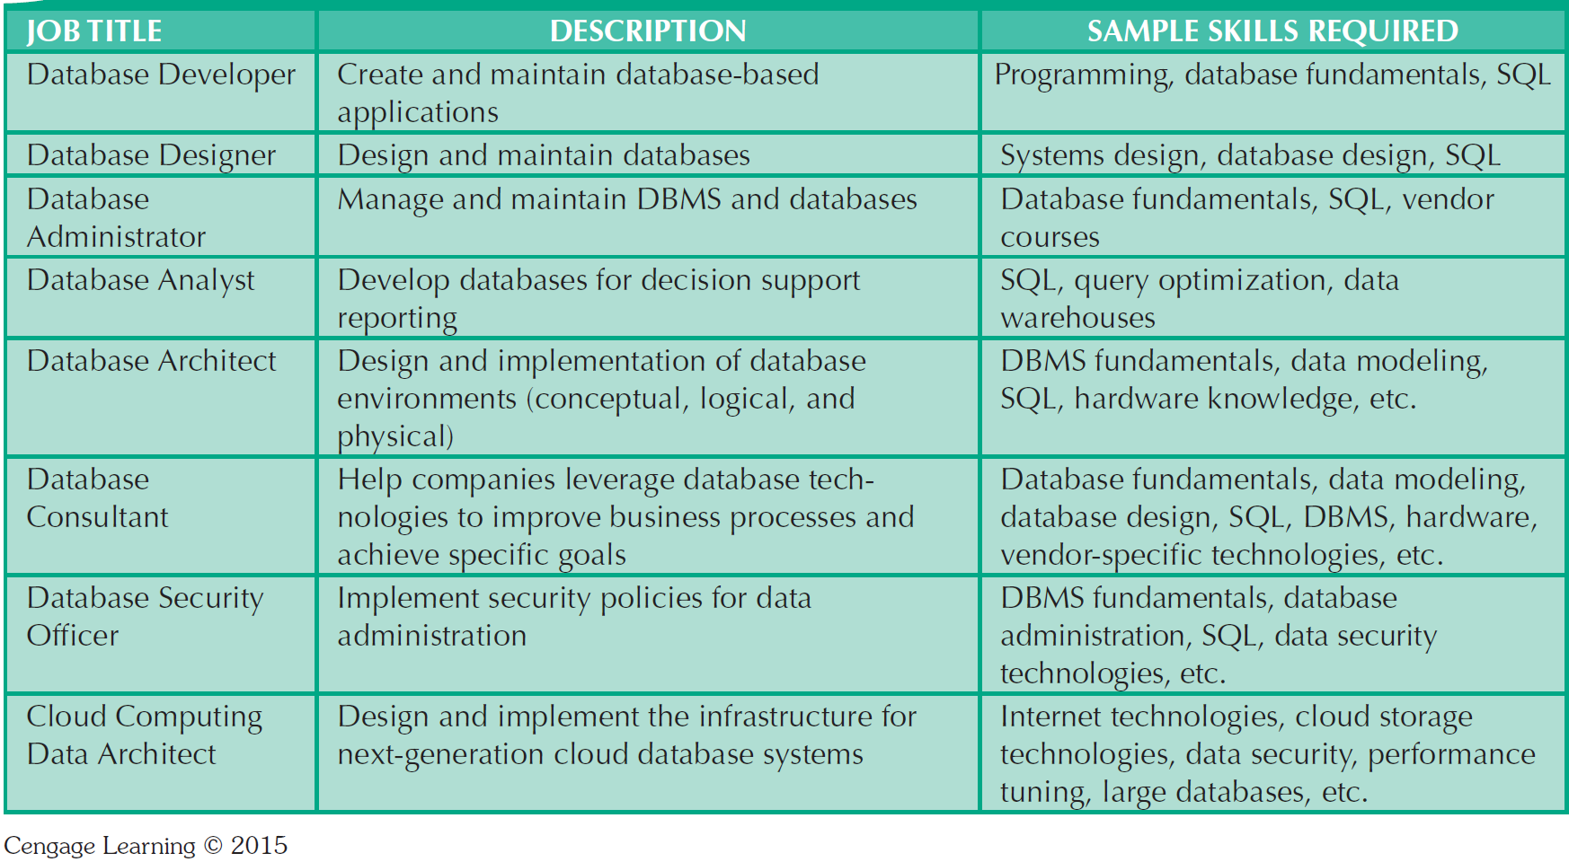
Table 1.3 - Database Career Opportunities

